Slide 1
DevOps
02 - Git
Павел Боев 02.2021

Slide 2
Agenda
Version Control Systems
Git history and basics
Main git activities
Merge / Rebase / Merge conflicts
Collaborating with remote repositories
Quick look into git systems

Slide 3
Version Control Systems
Systems for tracking changes to source code (and not only in nowadays)
Allow developers to:
View history of changes (why did I / someone changed file X on date Y)
Go back (revert) to earlier state of the code
Do parallel development (e.g do patch on Windows 8.1 and patch on Windows 10 at the same time)
Collaborate better (everyone has access to the “latest” modifications)
Avoid losing work by backing up the code in central place
Types - centralized (client-server) or distributed (DVCS)

Slide 4
Git basics
Created by Linus Torvalds in 2005 for the purposes of version control of the Linux kernel development
Stores data about files as series of snapshots
If a file is modified in a given commit – stores new snapshot of the file
If a file is not modified in a commit – stores pointer to previous snapshot
Distributed VCS
Every user has a full backup of the repository
Most operations are local and fast
Every change is hashed before its stored – impossible to modify file, without git knowing it

Slide 5
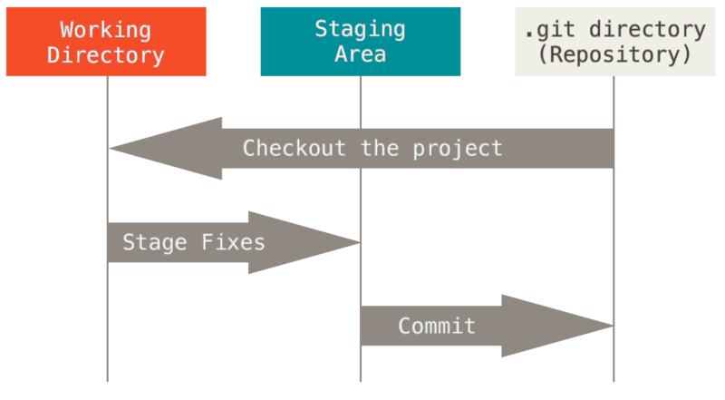
Git basics contd.
State of files in Git
Untracked – Git does not know about it
Modified – changes were made to the file, but the changes have not been committed in the DB yet
Staged – files, which will go in the database with next commit
Committed – Safely stored in the database
Additional terms
Working directory (tree) – checkout of single version from the local DB onto the disk. You make changes to files in the working tree
Staging area – index, which stores what will go with the next commit
.git directory – this is where Git stores local metadata (DB).

Slide 6
Repository handling
Repository – virtual storage of your project. Contains versions of your files
Every repository has hidden .git directory containing local DB, config, etc.
Creating new repository
git init – transform current directory in a git repository
git init <directory> - create new, empty git repository in <directory>
Cloning repository from somewhere
git clone <url> - creates full local copy of the repository, pointed by <url> in the current directory

Slide 7
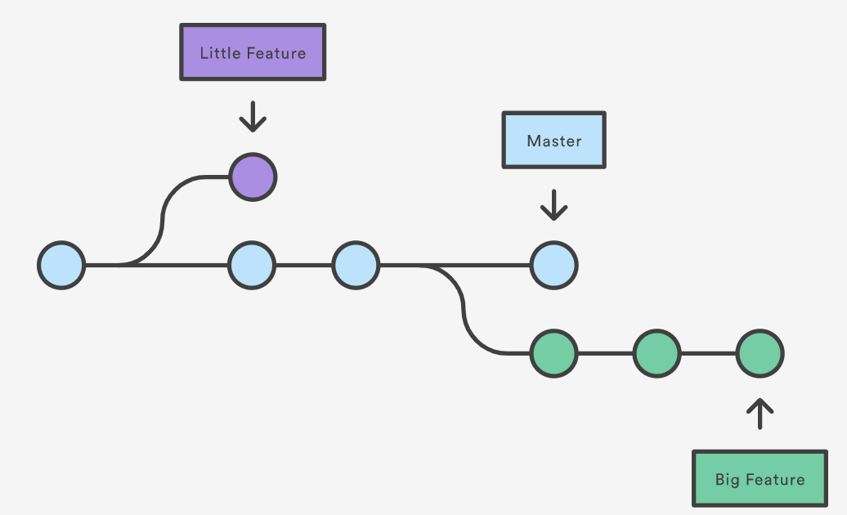
Branches
Branch is pointer to commit
Branch is a line of development in the repository
HEAD – special pointer to the local branch you are currently on
git branch <name> - creates a new branch
git checkout <branch_name> - switches to branch_name (moves HEAD to branch_name)
master / branch – Github flow
master/develop/ [feature/release/hotfix]- Git Flow / Bitbucket flow.

Slide 8
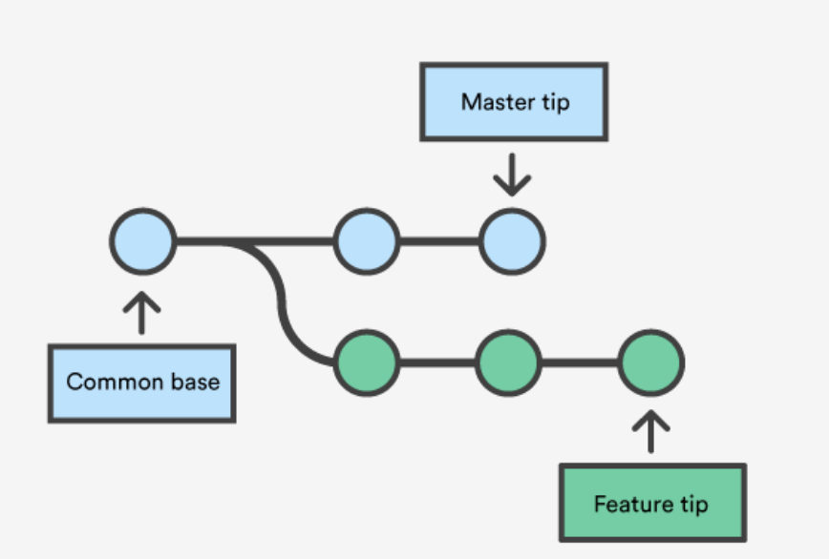
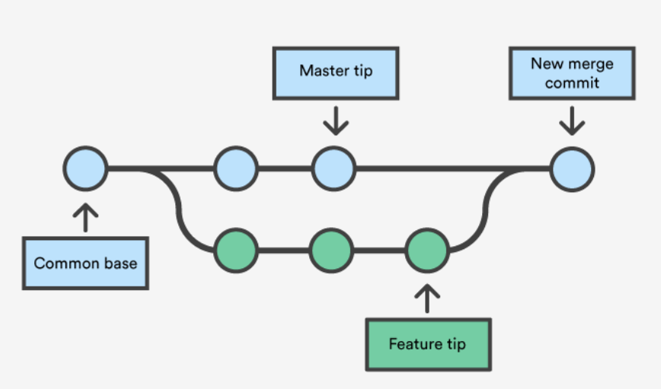
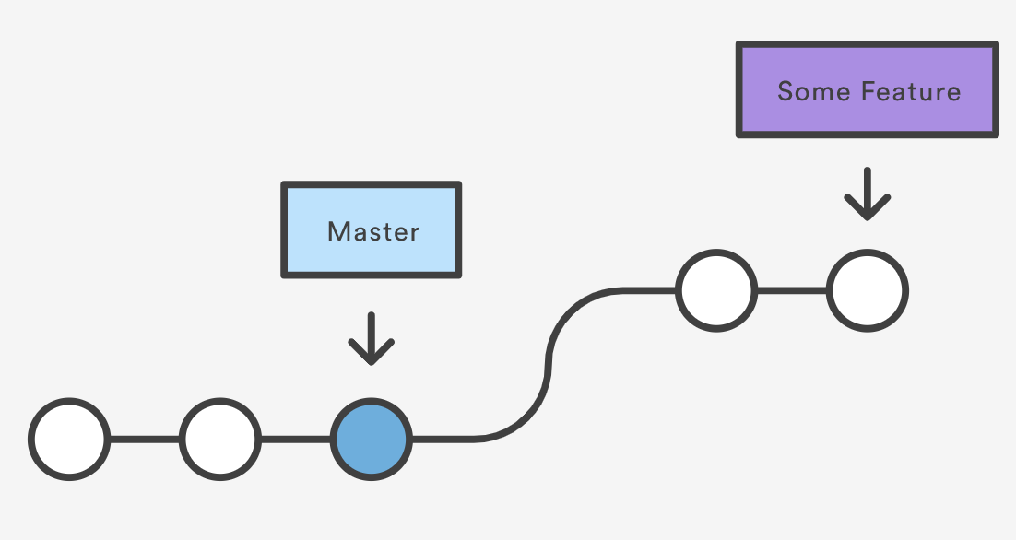
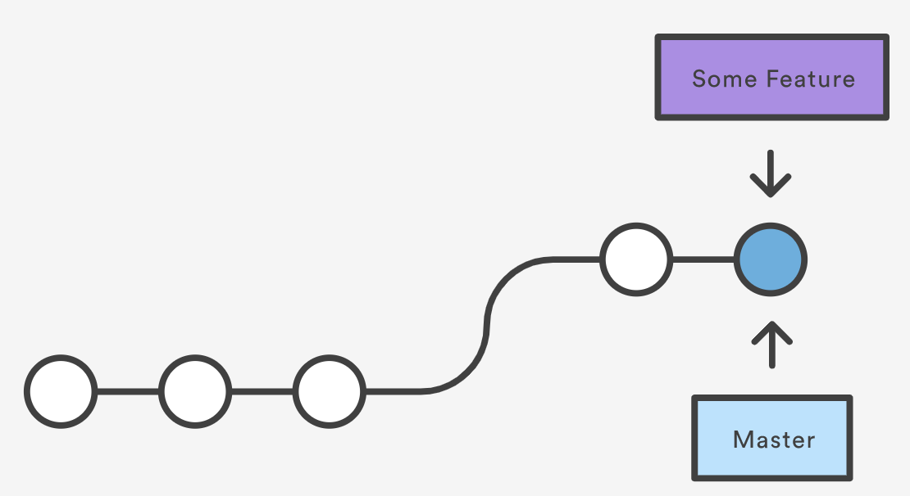
Merge
Merge allows you to take independent lines of development and integrate them
git checkout <receiving branch>
git merge <branch-to-integrate>
3-Way merge
Fast Forward Merge
Resolving conflicts:
Find the conflicting lines
Choose which version to keep
git add – tell Git that the conflict is resolved
git commit – do the merge commit

Slide 9
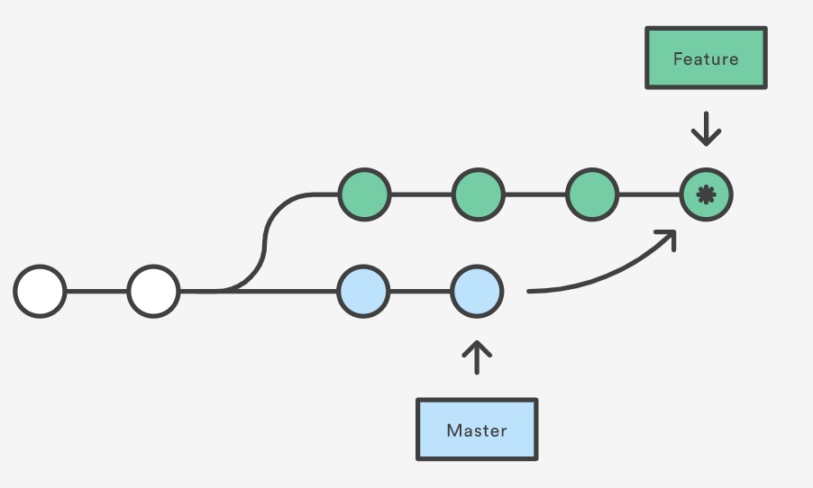
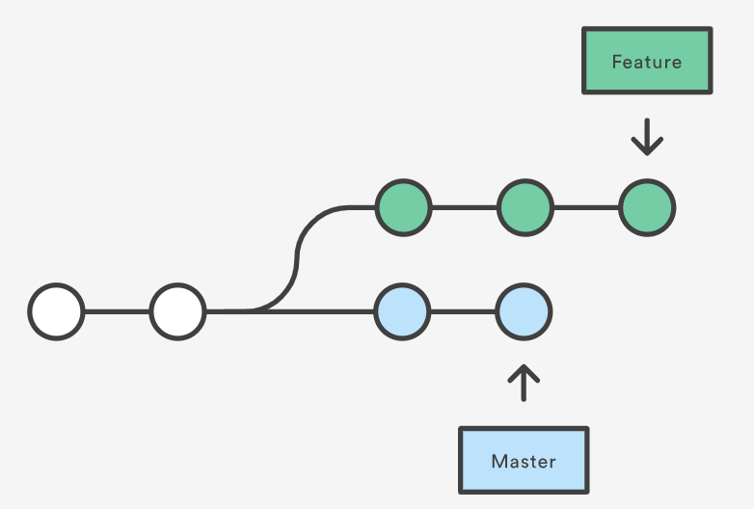
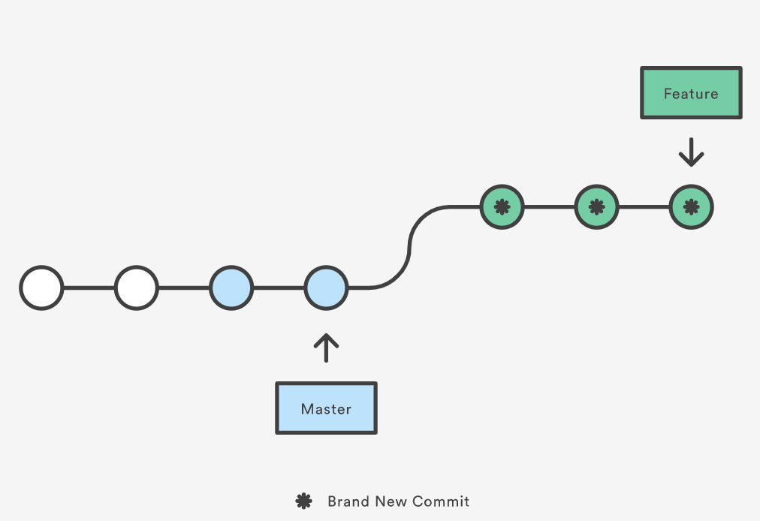
Rebase
Rebase is similar to merge as it integrates changes from two branches.
HOWEVER, REBASE REWRITES THE COMMIT HISTORY
!!! SO NEVER USE REBASE ON COLLABORATIVE (PUBLIC) BRANCHES !!!
merge
rebase

Slide 10
Benefits of rebase
Clean-up local history (interactive rebase onto earlier commit from your branch)
Incorporate upstream changes (rebase someone else’s work in your local feature branch)
Rebase before merge to allow fast-forward merge
Do not pollute feature branch history with merge commits from upstream
! Follow the established practices in your team

Slide 11
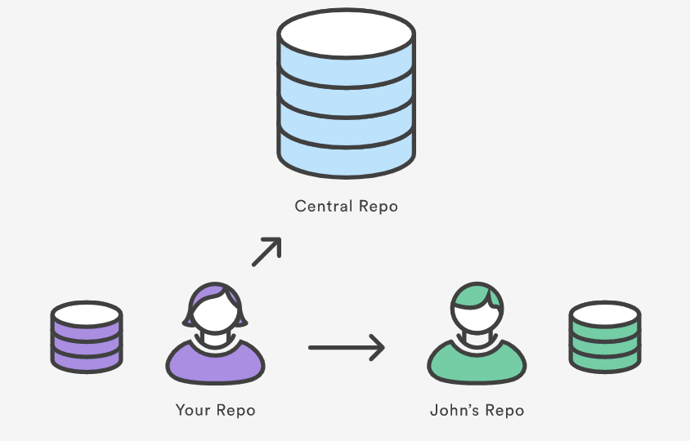
Fetch / Pull / Push
Remote repositories allow team collaboration
git remote creates “bookmark” to remote repository URL
origin – the remote repository from which we did ”git clone”
git fetch – get commits, files and refs from remote branch without updating your local branch
git pull – gets content from remote and immediately updates local repository
git push – transfer commits from your local repository to remote repository

Slide 12
Github / Gitlab
Github, Gitlab, Bitbucket, etc. are git servers with a lot of added features
issue tracking
CI engines
wiki / pages
team / group management
Pull Request (Github, Bitbucket) / Merge Request (Gitlab)
forum to discuss changes before they are merged
not a git feature by itself
typically needs to be approved by 1+ other developers
! Follow your team’s established practice

Slide 13
References
https://git-scm.com/book/en/v2 - Pro Git, a free ebook
https://www.atlassian.com/git/tutorials
https://en.wikipedia.org/wiki/Version_control

